Slide 1
Python tutorial for PHYS 3007

Slide 2
Downloading and Installing Python through Anaconda

Slide 3

Anaconda Python data platform
Anaconda is a popular data platform for Python and R and can be easily installed on their website https://www.anaconda.com/distribution/.
Anaconda comes preloaded with important scientific libraries for python such as Numpy, Scipy, Matplotlib, etc. Some of which we will make use of in this tutorial.
One of the key resources offered with Anaconda is Spyder, a Interactive Development Platform (IDE) for python. This IDE offers a IPython Console and scripting workspace that will be explored in the following slides.

Slide 4
Python basics

Slide 5
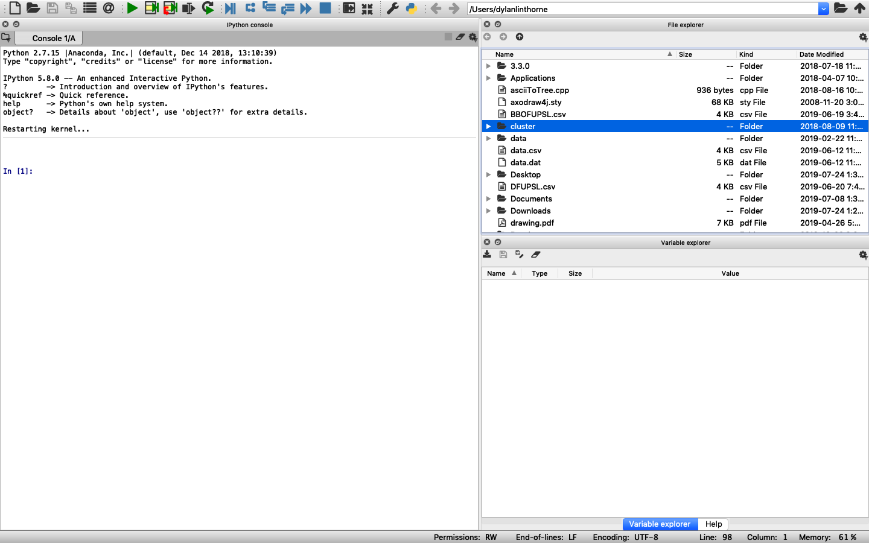
When you start Spyder for the first time, the application has a toolstrip at the top and several windows below:
toolstrip
File explorer
Command window
Names and values of
variables which have
been assigned values
and haven’t been cleared

Slide 6
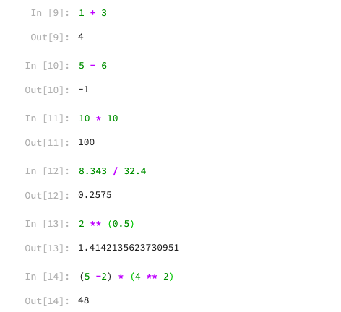
We will start with the IPython console, which is basically a powerful calculator
Expressions or commands are entered after the In [#]: symbol on the last line of the console
Here are some basic calculation examples:
Addition of two numbers
Subtraction of two numbers
Multiplication of two numbers
Division of two numbers
Exponentiation
More complicated expression

Slide 7
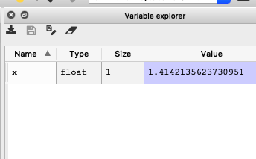
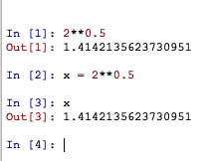
We can set values to variables, which can be seen in the variable explorer in the console
we can use this variable to work with the result of the previous expression without typing out the number

Slide 8
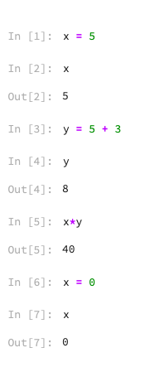
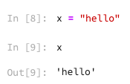
We can also assign values to our own variables and use them in expressions:
A string of text can be assigned to a variable too
The variable x has been overwritten with a new value

Slide 9
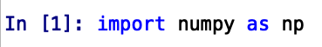
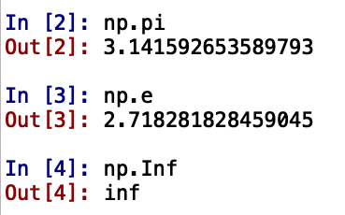
In Python the the Numpy and SciPy Modules/librarys are a current standard for mathematical functions and data types. We import libraries using the ‘import’ command
Numpy has dedicated constants, such as Pi, Euler’s Constant, etc
Set np as module shortcut

Slide 10
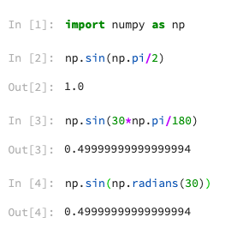
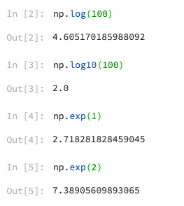
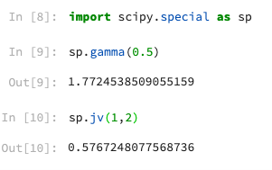
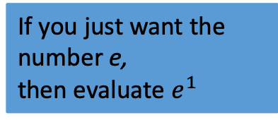
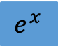
Numpy and SciPy together include most elementary and special math functions, for example:
Logarithm base e
Sine with argument
in radians
Gamma function
Logarithm base 10
$$e^{x}$$
Bessel function of the first kind of order 1, evaluated at x=2
If you just want the number e,
then evaluate $e^{1}$
Sine with argument
in degrees

Slide 11
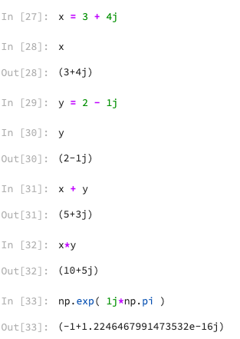
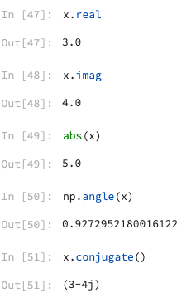
You won’t need them for most experiments but Python can also do computations with complex numbers
The character j is the imaginary unit (as long as you haven’t used them as variable names) and must be multiplied bya unit (ex. 1j, 2.3j)
Real part
Imaginary part
Absolute value / modulus / magnitude
Argument / phase angle (from numpy module)
Complex conjugate

Slide 12
Vectors and matrices

Slide 13
Things get a little more interesting when we start working with Python arrays, or, vectors (1-dimensional arrays) and matrices (2-dimensional arrays)
A vector is essentially an ordered collection of a finite number of elements
It can be a row vector with m elements (i.e. a 1 x m matrix) or a column vector with n elements (i.e. a n x 1 matrix)
Numpy has dedicated array data types that can be easily manipulated, arrays in this tutorial will be imported from the numpy library/module

Slide 14
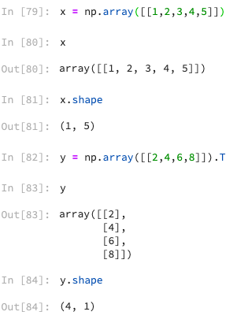
A row vector can be created by entering numbers within square brackets, separated by commas
A column vector can be created by entering numbers within square brackets and applying the transpose operation ‘T’ on it.
x is a row vector
Shape gives us the dimensions of the array (row vector)
y is a column vector

Slide 15
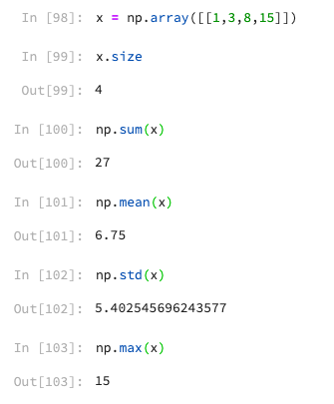
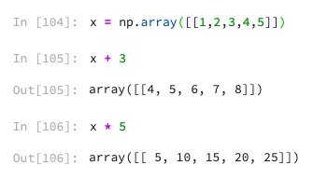
Some summary statistics for elements of a vector:
Adding/multiplying all elements of a vector by a scalar:
Number of elements
Sample standard deviation

Slide 16
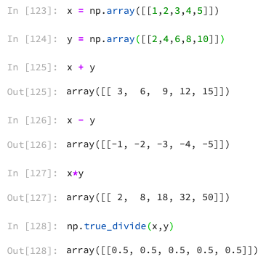
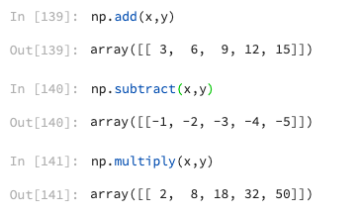
If two vectors have the same dimensions, they can be added, multiplied, etc. element-by-element:
* is generally used for matrix multiplication (i.e. multiplication of a m x n matrix by a p x q matrix, for which n must equal p)
To ensure that you are applying the right function it is best to use the dedicated numpy functions for (multiply, add, ect)
The ‘/’ operator doesn’t give true division so we can use the numpy ‘true_divide()’ function instead

Slide 17
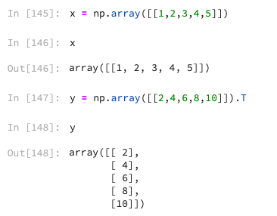
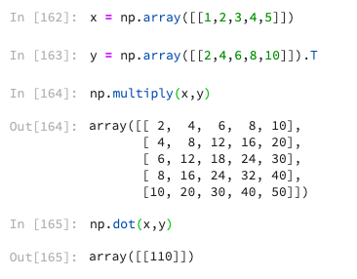
Matrix multiplication functions can be used to create higher dimensional arrays (i.e matrices) or lower dimensional arrays (i.e scalar from the inner product).
x is a row vector
y is a column vector

Slide 18
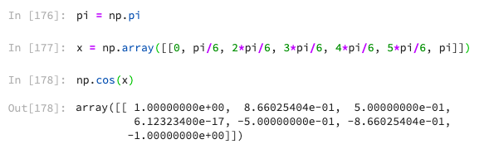
The math functions also accept vectors as arguments, outputting a vector consisting of the function evaluated at all the elements of the input vector:
Set a variable to pi, to save typing time

Slide 19
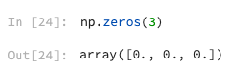
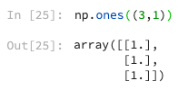
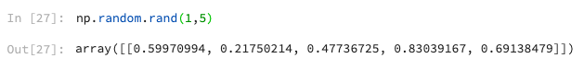
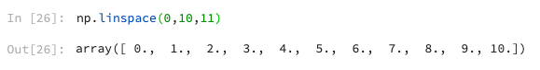
Manually creating vectors using square brackets is only done occasionally. Here are some other ways to create vectors:
Random number generated is part of the random sublibrary and is called before the function using ‘.’
Create an array of all zeros, with 1 row and 5 columns
Create an array of all ones, with three rows and 1 column
Create an array of uniformly distributed random numbers in the interval (0, 1)
Create a (row) vector with 11 elements linearly spaced from 0 to 10, inclusive

Slide 20
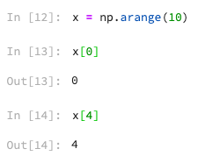
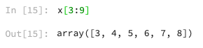
Individual elements of an array can be accessed using array indexing
NB: like many other programming languages, In Python the first element of an array has index 0, but in MATLAB the first element of an array has index 1
You can also access a range of elements in a vector using array slicing
Get the 1st element of x
Get the 5th element of x
Get a vector of all elements of x from 4 to 9 (inclusive)

Slide 21
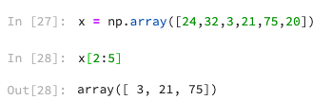
3:9 is shorthand for 3:9:1, which means start at i=3 and take steps of 1 (middle number) until you reach i=9, so slicing is just indexing using another vector.
When indexing with a vector, a new vector is returned containing the elements located at the indices in the indexing vector
Get a vector of elements of x at indices 2,3,4 (in that order)

Slide 22
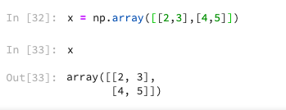
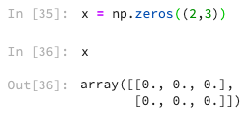
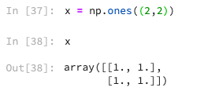
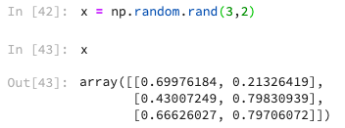
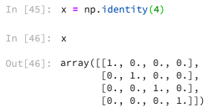
A matrix ( or 2 dimensional array) can be created using an extra set of square brackets to signify a new row.
It can also be created with zeros, ones, rand:
You can create an n x n identity matrix:

Slide 23
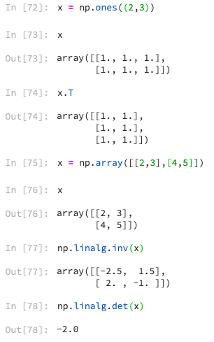
You can transpose a matrix, find its inverse (if it has one), find the determinant:

Slide 24
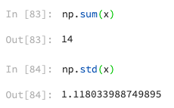
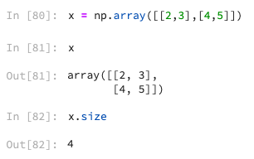
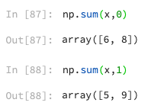
Determining the number of elements in a matrix is the done the same way as for a vector:
The summary statistics return a the statistics using every element of the matrix:
Alternatively you can find the statistics of for each column (row):
The second input denotes the axis to sum over 0 = columns, 1 = rows

Slide 25
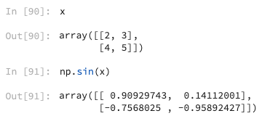
Math functions also accept matrices as arguments:

Slide 26
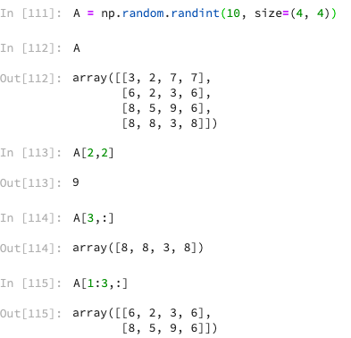
Matrices can be indexed and sliced
‘:’ means all rows (or all columns)
Get the element in row 2, column 2
Get all columns of last row
Get all columns of rows 1 to 2

Slide 27
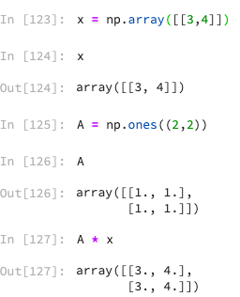
A matrix can be multiplied with a vector or a matrix multiplied with another matrix, as long as the dimensions are compatible

Slide 28
Scripts

Slide 29
Except when doing some simple one or two line calculations, entering commands one-by-one in the command window quickly becomes inefficient and tedious, for example, when you realize you need to make a change to a command you entered 10 lines ago
When performing more complex tasks, such as plotting or data analysis for your experiments, you will want to create a script, which is a file containing all of the commands you need to accomplish your task and in which you can edit any line or add new lines at any point. The commands are executed sequentially when the script is run.

Slide 30
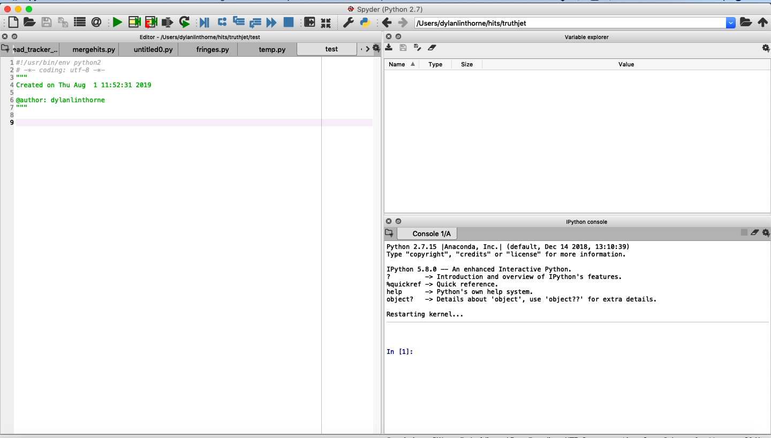
To start a new script, click new file on the toolstrip

Slide 31
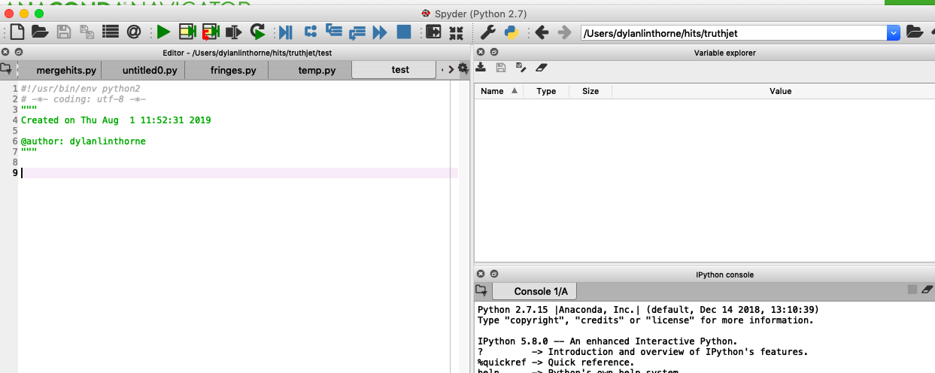
A new Editor window will appear with a new Untitled script
A Save button will also appear in the toolstrip.

Slide 32
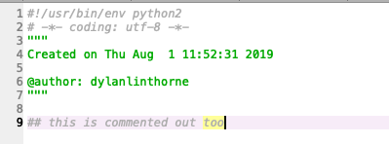
Before getting to some commands, any text in the script appearing behind a # or between ””” “”” or ‘’’ ‘’’ symbols will be a comment
The purpose of comments is to annotate lines of code to explain what the code is doing in plain English.
This helps you to figure out what is going on when you go back and look at your code after two weeks, or for your TA to understand the code when attaching it to your lab report.
It may be a good idea to include comments at the top of each script stating your name, the date the script was created, when it was last modified, and a short description of what it does:

Slide 33
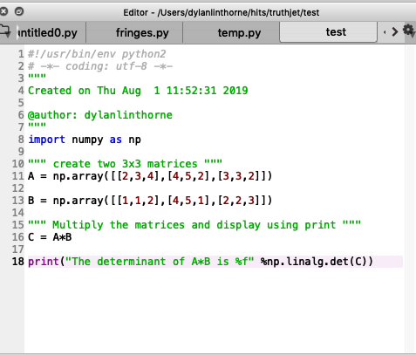
As a first example we will write a short and simple script
We will create two matrices and display the determinant of their product
The function print() allows you to print strings with the values of variables in your code inserted into it, formatted however you like.
In this case the determinant is printed as a floating point number

Slide 34
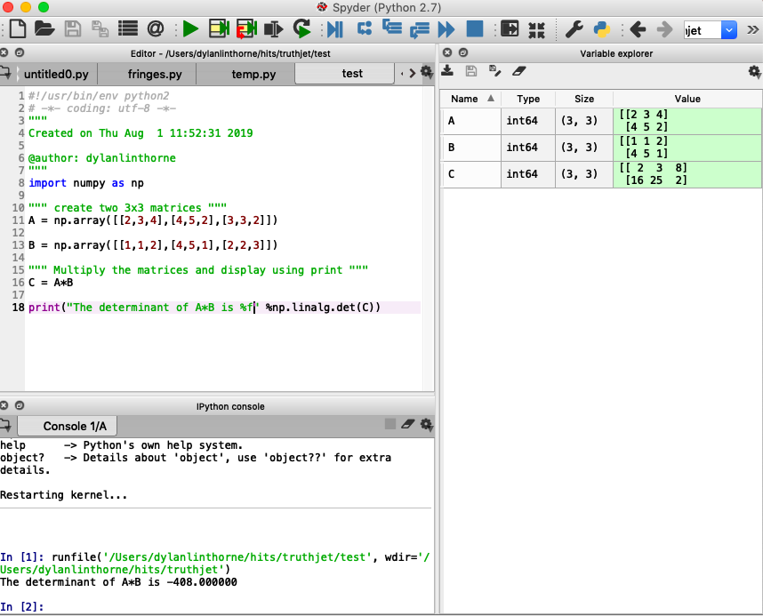
You can execute the script by clicking the green play button in the toolstrip
Any output from your script will be printed in the command window
Any variables created in your script will appear in the workspace

Slide 35
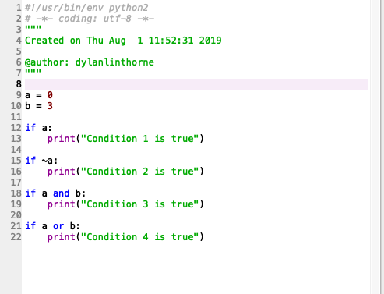
Conditional statements in Python – if block
Write ‘if’ followed by the logical expression to be evaluated and :
Indentation signifies the statement is within a block, anything inside
The indented block will be evaluated
If the logical expression evaluates to True, the code inside
of the if block will be executed.
~ is the NOT operator, ’and’ is the AND operator, ‘or’ is the OR operator
In this example, conditions 2 and 4 are True

Slide 36
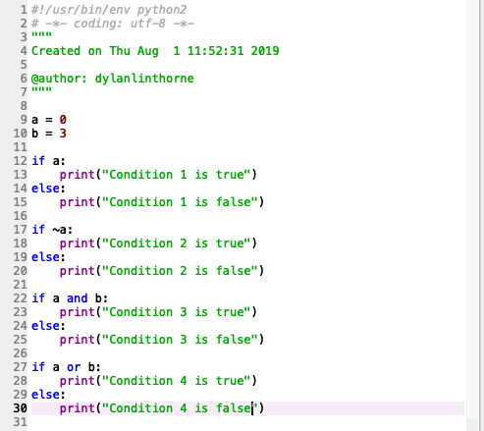
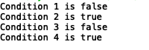
Conditional statements in Python – if-else block
Adding an else block to an if block allows alternative code to be executed if the logical expression evaluates to False
The ‘else’ statement is not followed by a logical expression to be evaluated
Output:

Slide 37


Conditional statements in Python – if-elseif-else block
Adding elif blocks in an if blocks allows for other conditions to be tested before resorting to the else block
Only the code in the first if/elif block for which the condition is True (or the code in the else block if none are True) will be executed
Output:
The ‘elif’ statement is followed by a logical expression to be evaluated
A final else block is not required

Slide 38


For loops in Python iterate over the elements of a list
The loop variable one-by-one assumes the value of each element of the row vector, and executes some code using that value
Output:
Loop variable (can use
whatever name you want)
Use of loop variable
inside loop block
Loop list

Slide 39


The loop list can be a variable containing a list (as shown on the previous slide) or the list can be created right on the loop line
These both of the same output. The range()
Function creates a list between (x,y) in increments
Of one digit. In this case, range(2,7) = [2,3,4,5,6]

Slide 40
Reading data from files

Slide 41
For some experiments, the instruments will record data in a .txt, .csv, or some other file
If a camera or scanner is involved, the saved images constitute part of your raw data
We want to import this digital data into Python, converting it into vectors or matrices (arrays) in order to manipulate it
In other cases you might be manually changing a parameter and recording the output of some instrument (e.g. multimeter). In this case the data should be recorded in your log book, but you can also enter it into e.g. Microsoft Excel and save as a .csv or manually create vectors of the data in Python, etc.

Slide 42

Let’s start with some code for reading in the data in the text file ‘gaus2.txt’
This file consists of 100 lines, each line having three numbers separated by some white space (a single space in this case)
Here are the first few lines (file contents viewed using Notepad):

Slide 43
Let’s start with some code for reading in the data in the text file ‘gaus2.txt’
This is simulated data that does not have any physical meaning. The first number in a row is the independent variable or x-axis data, the second number is the dependent variable or y-axis data, and the third number is the uncertainty on the y data
Note: the data in the file are not ordered by x value

Slide 44

To access the data in MATLAB, we need to determine the path of the file in the file system and enter it as a string
On Windows, you can determine the path by right-clicking on the file and selecting “Properties”. You can highlight and copy the Location. Note also the file name and file type

Slide 45

Start a new script and assign the location of the folder containing the data file and the file name to variables
Note: the file extension ‘.dat’ has been added to the file name

Slide 46

Having constructed the file path, let’s read in the data from the text file
To do this we can use the numpy loadtxt() function, passing the file path as an argument
After running the code, we see that the “value” of the variable into which we read in the data is a 100x3 float32. This means it is a matrix with 100 rows and 3 columns of floating-point numbers

Slide 47

Again, we can inspect the contents of the matrix by double clicking on the variable name in the variable explorer
The first column of the matrix contains the x data, the second column contains the corresponding y data, and the third column contains the corresponding y uncertainty data

Slide 48

What if the data has headers?
Sometimes the data file will include descriptive information in the first few lines, as is the case for ‘gaus2_with_headers.txt’
While helpful when viewing the file, we don’t want to read in the headers with the rest of the data

Slide 49

What if the data has headers?
Headers can easily be skipped by passing a the skiprow argument
The first argument is the file path string
The second argument is the number of rows to skip in the file. Here there are 3 lines of header information.

Slide 50


What if the data is a .csv file? E.g. ‘gaus2.csv’ in the first figure
Then can use loadtxt() with ‘,’ as the delimiter (second figure)
By definition of csv, the
character separating
numbers in each row (the
delimiter) is a comma

Slide 51

After reading the data from a file, it is contained in a single variable as a matrix
It is helpful to break up the matrix so that there is one vector for each independent variable, one vector for the dependent variable, one vector the uncertainty on the dependent variable, and possibly vectors for the uncertainties on the independent variables
We can do this with matrix slicing:
x data is all rows of the first column
y data is all rows of the second column
y uncertainty is all rows of the third column

Slide 52
Sometimes the data will be contained in multiple files, each file formatted the same way and need to be processed the exact same way.
We could just change the file_name variable and run the code for each file
But if there are many files, it will be more efficient to loop over the files (as long as they are stored in the same directory)

Slide 53
Plotting

Slide 54

Matplotlib is the basic graph plotting library/module in Python
The most basic way to use it is to pass two vectors (of the same size) to the function, the first vector being the x-axis data and the second vector being the corresponding y-axis data
As a first example, let’s plot a sine function. Let’s say it’s a voltage as a function of time with amplitude 20 V and a frequency of 1 Hz.
Let’s plot two cycles, from 0 to 2 seconds. To start, create an x-vector with 10 linearly spaced points from 0 to 2 and evaluate the appropriate sine function at those points
We will import matplotlib with the alias mpl for later use.

Slide 55

And then plot them:
By default, the plot function opens a new figure window and joins the points of the vectors in order with lines of some thickness and colour. Tick marks are drawn on all four sides and some automatic tick labels appear on the bottom and on the left. The axis limits are automatically set. There are no axes labels, titles, etc.

Slide 56


The sine wave looks jagged because we didn’t sample points densely enough
Instead of 10 points between 0 and 2 let’s try 1000 points:

Slide 57

Note that the second time we ran the plot function, a new figure window didn’t open. The new plot was made in the existing figure window (assuming you didn’t close it) and overwrote the content.
To plot two (or more) curves in the same figure window, just add more x and y vectors to the plot() call:

Slide 58


You can add a title and axes labels to a plot
The labels, title, etc.

Slide 59


The line style, marker style, and colours of a curve can be modified by passing a Linestyle string as a argument to the plot() function
Different line style option are available, below are some examples and key strings.

Slide 60


Besides the LineSpec string, we can also specify properties of a curve by passing name-value pair arguments to the plot() function
Like the marker symbol

Slide 61

Sorting data arrays
When dealing with data that isn’t sorted/ordered numerically, we can take advantage of the numpy sort() and argsort() functions to sort the final data set.
Import the unsorted data and
Break it up into x and y arrays
The first function np.sort() will sort the x_data and update the x_data array
The second function np.argsort() gives the index numbers of the old array if it were sorted, which we put into the array ‘data1_index”
Finally, we can sort the y_data with the new sorted index array ‘data1_index’

Slide 62

Before proceeding to changing the axes properties of a plot, let’s add some code to read in the data from gaus1.txt and gaus2.txt (and then plot them)

Slide 63


We can add titles to the plot and axis.
Axis properties can also be changed by adding to the pyplot function
You can also specify for which axes you want to set the xlabel/ylabel/title
Let’s pretend the gaus data were intensity vs position measurements

Slide 64

You can add grid lines:
And also change the grid style and colour by adding/passing to the gird() function.

Slide 65

When you have more than one curve on the same plot, you need to indicate which curve is which
We can do that with a legend:
Loc to specify the Location of the legend ( 1 = upper right)
Pass in label strings in the order that plots were added to the axes

Slide 66

Notes on identifying curves on a plot:
It is a bad idea to simply use colour to distinguish curves. When the figure is printed with a black and white printer or if the reader is colour blind, the curves may be indistinguishable
Vary the line width or line style (in addition to the colour, if you wish):
Having separate plot() commands for each curve allows for individual setting of curve/line styles and colours

Slide 67

Notes on identifying curves on a plot:
Rather than using a legend, it may be better to just label the curves directly
It is possible use the annotation() function in pyplot but it is a little tricky because you need to determine the normalized figure coordinates at which to start and end the annotation
It may be easier to export the figure to MS Paint or to Inkscape if you want to add labels

Slide 68

Plotting with error bars
If you want to make a plot with error bars, then use the errorbar() function instead of the plot() function
For plotting with error bars on y only, pass a third vector containing the uncertainty for each point

Slide 69

Plotting with error bars
For plotting with error bars x and y, you need to pass two additional vectors , the third and fourth entries being the error on y and x, respectfully:

Slide 70

Logarithmic axes
You can change the axes properties XScale and YScale from ‘linear’ to ‘log’ or you can use the functions semilogx(), semilogy(), or loglog() instead of plot():

Slide 71

Logarithmic axes
You can change the axes properties XScale and YScale from ‘linear’ to ‘log’ or you can use the functions semilogx(), semilogy(), or loglog() instead of plot():

Slide 72

Logarithmic axes
You can change the axes properties XScale and YScale from ‘linear’ to ‘log’ or you can use the functions semilogx(), semilogy(), or loglog() instead of plot():
Generate 100 logarithmically spaced points from 10^1 to 10^3

Slide 73
Curve fitting

Slide 74

As a first example we will fit a Gaussian function to some Gaussian-shaped data (gaus1.txt)
It is common that we have some Gaussian-shaped data and want to find the centre of the Gaussian, using the width of the Gaussian as the uncertainty on the centre location
We usually disregard the individual uncertainties on the measured data points when doing this
First, get the data into Python:

Slide 75

SciPy curve fitting
To fit a general set of functions we will make use of the SciPy scientific library. More specifically, we will be using the optimize sublibrary in SciPy
We can import the module/library in the same manner as numpy/mathplotlib (we will use the alias sp)

Slide 76

Scipy, although very powerful, does not have a set of fit model templates. Meaning, we have to define our own guassian function to fit the data.
To define your own function, we use the ‘def’ operator followed by the name of the function and the variables/parameters that are passed to it.
The form of the ‘gauss1’ model is y = A*exp(-((x-mu)/sigma)^2)
The first variable we pass to the function is going to be x (dependent variable)
The passed variables are then used to evaluate the function we create and returns the value

Slide 77


Example:
We call the function for (x =1, A = 1, mu = 0, sigma = 1) and set it to a variable that we then print to screen
Output:

Slide 78
Curve_fit in Scipy
Now we can use the curve_fit() function using our ‘gaus1.dat’ and our defined gaus() function as the model to fit to data.
Curve_fit() returns two objects: A array/vector of calculated parameters for our model (A, Mu, sigma) and a covariance matrix that we will ignore right now.
Coeff will be the vector of fit parameters
We pass the gauss function first with the x and y data following

Slide 79

By default, the fit function runs some algorithm to minimize the following expression:
$$\sum_{i=1}^{N}{{\left(f\left(x_{i}\right)− y_{i}\right)}^{2}}$$
Where N is the number of data points, the $x_{i}$ are the values of the independent variable vector and the $y_{i}$ are the values of the dependent variable vector.
$f\left(x_{i}\right)$ is the model function evaluated at each value of the dependent variable (in this case, the gauss() function).
The expression is minimized with respect to the parameters, i.e., Curve_fit() finds the values of the parameters in the fit function that minimize the expression.
This is known as Least Squares, since it finds the minimum sum of squares of the difference between the measured dependent variable values and the model calculated dependent variable values

Slide 80

We can view the contents of the fit output by inspecting the coeff variable that holds the fit values.
We can see that the calculated parameters
Are (A = 0.7999, mu = 1.995, sigma = 0.499)
The parameter ‘mu’ is the location of the centre of the Gaussian. The parameter ‘sigma’ is the standard deviation.

Slide 81

We can access the parameter values from the fit object variable using dot notation
Let’s plot the data along with the fitted Gaussian to visually inspect the quality of the fit
Again, let’s pretend the gaus data were intensity vs position measurements
The fit looks all right

Slide 82
The results of the fit are:
Centre of the bump is at mu = 1.9953 cm
The width of the bump is sigma= 0.4988 cm
Using the standard deviation of the Gaussian as the uncertainty of the bump location, we conclude that the centre of the intensity bump is at
(2.0 +/- 0.5) cm

Slide 83
Next let’s fit a curve to some data, taking into account the uncertainties on the data points. We will use chi-squared minimization as a fitting procedure
Let’s fit a curve to the data in malus3.txt
The expected shape is sine squared
Here we don’t have any uncertainties on the x variable. If there are uncertainties on x, and they are much smaller than the uncertainties on the y variable, they can be ignored
(more precisely, if variations in x on the order of σ_{x} result in variations in the measurement of y much smaller than σ_{y}, then we can neglect σ_{x} when fitting)
Since we have some control over the independent variable, it is often the case that σ_{x} will be relatively small and can be neglected when fitting

Slide 84

First, read the data and plot it:

Slide 85
The form of the function that we want to fit is a generic sine squared with four parameters: f(x) = a₁ * sin²(a₂*x + a₃) + a₄
where a₁ encodes the amplitude, a₂ encodes the frequency information, a₃ encodes the phase shift, and a₄ encodes the DC shift
Let’s again assume that the data is intensity (in W/m^2) vs position (in cm)
Since the variables have units, some of the parameters have units too. a₁ has units W/m^2, a₂ has units rad/cm, a₃ has units rad, and a₄ has units W/m^2

Slide 86

To do the fit, we introduce the χ² function (“chi-squared”; χ is written out as “chi” and pronounced as “kai”):
$${\text{χ}}^{2}=\sum_{i=1}^{N}{\frac{{(y_{i}−f(x_{i};a_{1}, …, a_{m}))}^{2}}{σ_{i}^{2}}} ,$$
Where N is the number of data points being fitted to, the x_{i} and y_{i} are the values of the independent and dependent variables, respectively, for each data point, and the σ_{i} are the uncertainties on the y values for each data point. $a_{1}, …, a_{m}$ are the m parameters of the fit function

Slide 87

In our case of a sine squared fit function,
$${\text{χ}}^{2}=\sum_{i=1}^{N}{\frac{{(y_{i}−a_{1}\sin^{2}\left(a_{2}x_{i}+a_{3}\right){−a}_{4})}^{2}}{σ_{i}^{2}}} ,$$
The x_{i} are the positions, the y_{i} are the measured intensities, and the σ_{i} are the uncertainties on the intensities
Performing the fit means finding the values of the parameters for which the value of χ² is minimized. Call these values $a_{1}^{∗}$, $a_{2}^{∗}$, …
The method of curve fitting by minimizing χ² is a form of Weighted Least Squares (with weights 1/$σ_{i}^{2}$)

Slide 88


Before proceeding to find the values of the parameters of the fit function that minimize χ², since the measurements have uncertainties, the fit parameters will have uncertainties too.
The uncertainties on the parameters are determined as follows:
Form the curvature matrix of the χ² function at its minimum
Then, the inverse of the curvature matrix is the covariance matrix
$$α_{ij}={\left.\frac{1}{2}\frac{∂^{2}χ^{2}}{∂a_{i}∂a_{j}}\right|}_{\vec{a}={\vec{a}}^{∗}}$$
For m parameters, this is an m x m matrix
Where $\vec{a}$ is the vector of parameters and ${\vec{a}}^{∗}$ is the vector of best fit values for the parameters
$$ε_{ij}={\left(α_{ij}\right)}^{−1}$$

Slide 89

$ε_{ij}$ is also an m x m matrix (or in our case, a 4x4 matrix since the sine squared fit has four parameters)
$ε_{ii}$ is the variance of fit parameter $a_{i}$, and so $\sqrt{ε_{ii}}$ is the uncertainty of parameter $a_{i}$
$ε_{ij}$ for i ≠ j is the covariance of parameters $a_{i}$ and $a_{j}$
$ε_{ij}$ = $ε_{ji}$ (the covariance matrix is symmetric)
The covariance matrix is the second output of the Curve_fit() function that we had set to ‘var_matrix’in the last example

Slide 90


Finding the parameter values that minimize χ² for our chosen fit model as well as the covariance matrix is done in the same way using curve_fit(). You just need to include the weights in the fit function call
If a y_err vector, is passed to the fit function (with the argument title sigma) the following expression is minimized:
$$\sum_{i=1}^{N}{{\left(\frac{f\left(x_{i}\right)− y_{i}}{σ_{y}}\right)}^{2}}$$
Curve_fit is now doing Chi^2 fitting

Slide 91


You can provide a vector of initial guesses for the fit parameters by using a argument name pair “p0‘’.
Sometimes it helps to guess values that are pretty close to assist the fitting to settle at the right values.
Define function for custom model
Coeff
(contains parameter values from the fit)
Var_martrix (contains covariance matrix)
y_err is the vector of σ_{y,i}.
Here is our calculated covariance matrix (i.e var_matrix)

Slide 92

Aside: how I picked the start point
The standard sine squared curve oscillates from 0 to 1 and has a period of π.
As can be seen on the plot a few slides ago, the curve oscillates from about -1 to 1 and has a period of about π
Therefore we need to scale the amplitude by 2 ($a_{1}$=2), shift the curve down by 1 ($a_{4}$=-1), and don’t do any frequency scaling ($a_{2}$=1)
The standard sine squared curve has a minimum at x=0. In the plot it looks like the curve is leading the standard curve by a quarter period, i.e. the phase shift is π/4 ($a_{3}$=π/4)

Slide 93


Running the code, we can obtain the parameter best fit values and the covariance matrix
That is, $a_{1}=2.017$ W/m^2, $a_{3}=0.9994$ rad/cm, $a_{2}=0.8400$rad, $a_{4}=−0.8006$W/m^2
$σ_{a_{1}}=\sqrt{9.67e−4}=0.0311$ W/m^2, $σ_{a_{3}}=\sqrt{1.867e−5}=0.00432$ rad/cm, $σ_{a_{2}}=\sqrt{2.68e−4}=0.01639$ rad, $σ_{a_{4}}=\sqrt{3.325e−4}=0.018233$ W/m^2
Or, $a_{1}=(2.017±0.031)$ W/m^2, $a_{2}=(0.999 ±0.004)$ rad/cm, $a_{3}=(0.840 ±0.016)$ rad, $a_{4}=(−0.801 ±0.018)$ W/m^2
Coeff
Var_matrix

Slide 94

Let’s plot the fit with the data

Slide 95

Having found the fit parameters, we can compute, for example, the intensity at an arbitrary position
Something to be aware of, however:
Suppose we wanted to evaluate the intensity at 4.2 cm
This is of course f(4.2) = a₁ * sin²(a₂*4.2 + a₃) + a₄ = 1.0106 W/m^2
To calculate the uncertainty, you might try to use the usual error propagation formula
$$σ_{f}^{2}=\sum_{i=1}^{m}{σ_{a_{i}}^{2}{\left.{×\left(\frac{∂f}{∂a_{i}}\right)}^{2}\right|}_{\vec{a}={\vec{a}}^{∗}, x=4.2}}$$
But the parameter covariances are non-zero so the more general formula needs to be used:
$$σ_{f}^{2}=\sum_{i,j}{{\left.ε_{ij}×\left(\frac{∂f}{∂a_{i}}\frac{∂f}{∂a_{j}}\right)\right|}_{\vec{a}={\vec{a}}^{∗}, x=4.2}}$$
where $ε_{ij}$ is the parameter covariance matrix

Slide 96

Based on the plot two slides ago, the fit looks okay but how can we quantify the goodness of fit?
First, let’s compute the value of the χ² function at its minimum (i.e. for which the fit function uses the best fit parameter values):
It is 121.4485

Slide 97

Next, if the hypothesized fit model we selected is the correct hypothesis, the minimum value of the χ² function, ${\text{χ}}_{min}^{2}$, evaluated for data sets collected for repeated experiments should follow the chi-squared probability distribution:
$$f\left(x;ν\right)= \frac{1}{2^{\frac{ν}{2}}Γ\left(\frac{ν}{2}\right)}x^{\frac{ν}{2}−1}e^{−x/2}$$
where $ν$ (Greek letter nu) is the number of degrees of freedom
$ν$ = no. of data points – no. of parameters
In our example, $ν=100−4=96$

Slide 98

What we do is calculate the probability, if our hypothesis is correct, of getting a ${\text{χ}}_{min}^{2}$ value greater than or equal to the one that we got
This probability is known as the p-value, and is computed as:
$$p=\int_{{\text{χ}}_{min}^{2}}^{∞}{f\left(x;ν\right)dx}$$
We can check if our p-value is less than some selected significance level, often taken as 0.05
If p < 0.05, then we reject the hypothesis that our chosen model is the correct. Otherwise, we fail to reject the hypothesis (that’s the strongest thing we can say; we are unable to conclude that the hypothesis is the correct one).

Slide 99

But getting a large p-value (i.e. >0.95) is also non-ideal. It means that we are overfitting the data (i.e. too many parameters in the fit model) or that our measurement uncertainties are too big
On average, we expect the p-value to be about 0.5 if the hypothesis is correct
Alternatively, the chi-squared distribution has an expectation value of $ν$, so if our calculated ${\text{χ}}_{min}^{2}$ ≈ $ν$, then we say the fit is ‘good’
${\text{χ}}_{ν}^{2}=\text{χ}\text{2}/ν$ is called the reduced chi-squared statistic. Based on the above, for a ‘good’ fit it should be about equal to 1
Typically it is more informative to report the p-value, the ${\text{χ}}_{min}^{2}$ and $ν$, rather than simply reporting the value of ${\text{χ}}_{ν}^{2}$

Slide 100


Calculating the p-value using the ‘stats’ library in scipy:
For our fit, we get p=0.0407, ${\text{χ}}_{ν}^{2}=1.2651$
The p-value is below 0.05. It looks like many of the data points are more than one std dev away from the curve. Maybe we need to retake the data a little more carefully or maybe our uncertainties on the intensities were slightly underestimated. Or maybe we were just unlucky.

Slide 101

Third example: let’s determine the radii of the fringes in the image ‘rgba_noise_2.tif’
First, read the image data into an array using Pyplots imread() function and average over the 3 colours channels and 1 alpha value channel to get an intensity matrix:

Slide 102
Next, since the image is circularly symmetric about the centre, we can just work with a horizontal profile through the middle of the fringe pattern
But since the image is a bit noisy, let’s take a narrow horizontal strip near the centre (say, 10 rows of pixels high) and average over the rows to smooth out the noise a little
If the strip is sufficiently narrow, the rings are approximately vertical over the strip and their curvature shouldn’t affect the average over the rows

Slide 103

We can grab a strip from the intensity matrix using array slicing
After averaging over rows, let’s plot the profile

Slide 104


In the plot of the intensity profile, use the cursor tool to find an x-coordinate for the left and right ends of each bump
For example, for bump 2 I’ll use x=34 and x=51 for the left and right ends, respectively

Slide 105

Create one 12-element row vector for all of these left-end coordinates and another row vector for the right-end coordinates
Also, instantiate 12 element row vectors with zeros that will hold the centres and widths of the 12 bumps (the elements will be determined one-by-one in a loop)

Slide 106



Next, we def a four-parameter Gaussian like we did in the previous example and loop over all the bumps, fitting the Gaussian to each one at a time
Bump centres
Bump Widths

Slide 107


Now, the first 6 bumps are from the left ends of the fringes (from largest radius fringe to smallest radius fringe) and the last 6 bumps are from the right ends of the fringes (from smallest radius fringe to largest radius fringe)
Create two vectors, one for the centres of the left sides of the fringes and one for the centres of the right sides of the fringes (from smallest radius fringe to largest radius fringe)
The radius is just half the distance between the right and left sides of a fringe
These radii are in units of pixels. In an
experiment you would want to convert
this to a physical distance in, for example, cm
You would also need to compute the uncertainties on the radii
Radii

Slide 108

Fourth example: read in and plot the data in ‘PMT1.txt’:

Slide 109




We will fit one line the rising region in the middle and one line to the flat region on the right and find the intersection point of these lines
We need to determine the range of indices for the two regions
First use the cursor tool to determine the x-coordinates of bounding points:
Rising region: x = 8.75 to x = 10.99. Flat region: x = 13.74 to x = 19.76

Slide 110




Rising region: x = 8.75 to x = 10.99. Flat region: x = 13.74 to x = 19.76
Then double click on the x_data variable in the workspace to determine the indices of these points:
Rising region: indices 61 to 68. Flat region: indices 82 to 99

Slide 111

Perform two separate linear fits, one in the rising region and one in the flat region
The form of a line is y = p1*x + p2

Slide 112



So the equations of the two lines are
y = 0.7346*x – 6.3927 & y = 0.0174*x + 2.1131
Determine the intersection point:
For an actual experiment, you would need to complete the calculations for the uncertainty on this point
Rise fit
Parameters:
Flat fit
Parameters:

Slide 113


Plot the lines and the intersection point with the data

Slide 114
Extra

Slide 115

Graphical method for determining uncertainties on fit parameters – 1 parameter
The graphical method for determining the uncertainty on a single-parameter fit will be demonstrated using the 1 parameter exponential data.
Read in the data and plot it:

Slide 116


Graphical method for determining uncertainties on fit parameters – 1 parameter
Perform the fit using chi-squared minimization. The function model is y = a*exp(-a*x):
The fit gives a parameter value of a = 0.5078
There was only one fit parameter so the covariance matrix is just the variance of that one parameter.
The uncertainty on a is
σ_{a} = 0.0157
The value of the ${ χ}^{2}$ function at its minimum is 25.8118

Slide 117


Graphical method for determining uncertainties on fit parameters – 1 parameter
The graphical method does not make use of the curvature matrix. We just computed them to compare the resulting parameter uncertainty with the following:
We will plot the $χ^{2}$ function, keeping all of the x, y, and σ_{y} data points fixed and varying only the parameter value. Plot the function in the vicinity of the best fit parameter value
Notice: the ${ χ}^{2}$ function is at a minimum for the parameter fit value a = 0.5078

Slide 118




Graphical method for determining uncertainties on fit parameters – 1 parameter
The uncertainty on the parameter value is the difference between the parameter value at which $χ^{2}=χ_{min}^{2}+1=26.8118$ and the parameter value at which $χ^{2}=χ_{min}^{2}=25.8118$ (a = 0.5078)
So plot the line $χ^{2}=26.8118$ and inspect at which value of a it intersects the $χ^{2}$ curve:
(zoom in)
$$χ_{min}^{2}+1$$
$$σ_{a}$$
Looks like $χ^{2}=26.8118$ at a = 0.523

Slide 119
Graphical method for determining uncertainties on fit parameters – 1 parameter
The uncertainty on the parameter value is the difference between the parameter value at which $χ^{2}=χ_{min}^{2}+1=26.8118$ and the parameter value at which $χ^{2}=χ_{min}^{2}=25.8118$ (a = 0.5078)
So $σ_{a}=0.5230−0.5078=0.0152$
This is pretty much the same value
as we found with the curvature matrix
method.
(zoom in)
Looks like $χ^{2}=26.8118$ at a = 0.5230

Slide 120
Graphical method for determining uncertainties on fit parameters – 1 parameter
This graphical method is a good approximation of the curvature matrix method for finding the parameter uncertainty
Exercise: show why the graphical method works

Slide 121

Graphical method for determining uncertainties on fit parameters – 2 parameters
The graphical method for determining the uncertainty on a two-parameter fit will be demonstrated using the 2 parameter exponential data.
Read in the data and plot it

Slide 122





Graphical method for determining uncertainties on fit parameters – 2 parameters
Perform the fit using chi-squared minimization. The function model is y = b*exp(-c*x)
The fit gives parameter values b = 0.3962
c = 0.2833
The uncertainties are
σ_{b} = 0.0125
σ_{c} = 0.0139
The value of the ${ χ}^{2}$ function at its minimum is 13.1281

Slide 123


Graphical method for determining uncertainties on fit parameters – 2 parameters
We will plot the $χ^{2}$ function, keeping all of the x, y, and σ_{y} data points fixed and varying both parameters. Plot the function as a surface in the vicinity of the best fit parameter values
Notice: the ${ χ}^{2}$ function is at a minimum at the best fit parameter values
Since this is extra material, you can learn how to use plot_surface() and meshgrid() here:https://matplotlib.org/mpl_toolkits/mplot3d/tutorial.html
https://docs.scipy.org/doc/numpy/reference/generated/numpy.meshgrid.html

Slide 124

Graphical method for determining uncertainties on fit parameters – 2 parameters
Now, restrict the z-axis range to be between $χ_{min}^{2}$ and $χ_{min}^{2}+1$, and view the surface looking straight down:
The result is an ellipse. At the centre of the ellipse, the chi-squared function has the value $χ_{min}^{2}$. The edge of the ellipse is where the chi-squared function is equal to $χ_{min}^{2}+1$.

Slide 125


Graphical method for determining uncertainties on fit parameters – 2 parameters
The uncertainties on the parameter values is determined as indicated in the figure:
That is, we find the distances between the ellipse tangents that are perpendicular to the parameter axes and the axis perpendiculars that go through the centre of the ellipse
$$σ_{c}$$
$$σ_{b}$$

Slide 126
Graphical method for determining uncertainties on fit parameters – 2 parameters
If there was no covariance between parameters b and c then the ellipse would not be tilted and we could determine the uncertainties by fixing e.g. c at its best fit value, plotting chi-squared vs b, and finding the difference between b values where chi-squared equals $χ_{min}^{2}$ and $χ_{min}^{2}+1$
If there is covariance, this simpler method would give uncertainties on b and c that are too small
If there are three or more parameters, you would need to find tangent hyper planes to a hyper ellipse

